Slide 1

Integers, Absolute Value, Comparing & Ordering
Review

Slide 2
Integers
Integers are all of the positive and negative whole numbers.
There are no fractions or decimals that are integers.
….. -3, -2, -1, 0, 1, 2, 3 …
Negative Direction
Positive Direction
-7 -6 -5 -4 -3 -2 -1 0 1 2 3 4 5 6

Slide 3
Graphing Integers on a number line
Draw a number line
Graph an Integer by drawing a dot at the point that represents the integer.
Example: -6, -2, and 3
-7 -6 -5 -4 -3 -2 -1 0 1 2 3 4 5 6
-7 -6 -5 -4 -3 -2 -1 0 1 2 3 4 5 6

Slide 4
Graphing Integers on a number line
Graph -7, 0, and 5
Graph -4, -1, and 1
-7 -6 -5 -4 -3 -2 -1 0 1 2 3 4 5 6
-7 -6 -5 -4 -3 -2 -1 0 1 2 3 4 5 6

Slide 5
Order Integers from Least to Greatest
You need to know which numbers are bigger or smaller than others, so we need to order them from least to greatest.
Example:
Order the integers -4, 0, 5, -2, 3, -3 from least to greatest.
The order is -4, -3, -2, 0, 3, 5.
-7 -6 -5 -4 -3 -2 -1 0 1 2 3 4 5 6

Slide 6
Order Integers from least to greatest
Order the integers 4,-2,-5,0,2,-1 from least to greatest.
Order the integers 3,4,-2,-5,1,-7 from least to greatest.
-7 -6 -5 -4 -3 -2 -1 0 1 2 3 4 5 6
-7 -6 -5 -4 -3 -2 -1 0 1 2 3 4 5 6

Slide 7
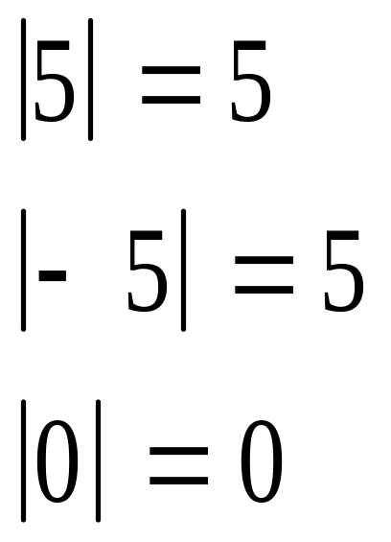
Absolute Value
Absolute value of a number is the DISTANCE to ZERO.
Distance cannot be negative, so the absolute value cannot be negative.
-7 -6 -5 -4 -3 -2 -1 0 1 2 3 4 5 6

Slide 8
Absolute Value
Evaluate the absolute value:
Ask yourself, how far is the number from zero?
| -4 | =
| 3 | =
| -9 | =
| 8 - 3 | + =
-7 -6 -5 -4 -3 -2 -1 0 1 2 3 4 5 6

Slide 9
Opposites
Two numbers that have the same ABSOLUTE VALUE, but different signs are called opposites.
Example -6 and 6 are opposites because both are 6 units away from zero.
| -6 | = 6 and | 6 | = 6
-7 -6 -5 -4 -3 -2 -1 0 1 2 3 4 5 6

Slide 10
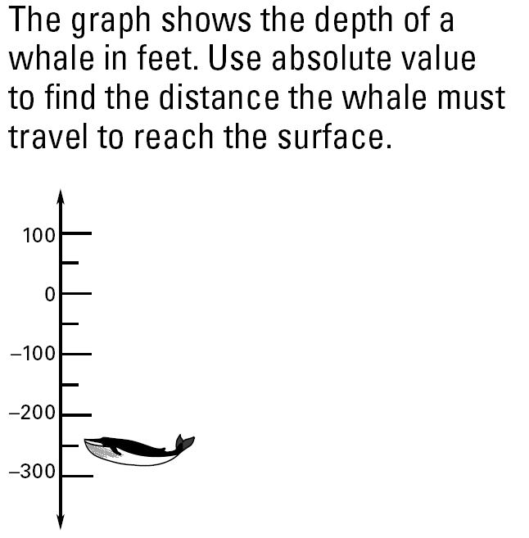
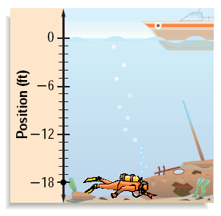
Using Absolute Value in Real Life
The graph shows the position of a diver relative to sea level. Use absolute value to find the diver’s distance from the surface.

Slide 11

Comparing Integers
Compare -4 and 1 using <, =, or >.
Remember, numbers increase going from left to right.
-4 < 1

Slide 12

Ordering Integers
Order the numbers -8, 7, -4, and 3 from least to greatest. Use a number line to plot the points. Then put them in order from least to greatest.
Remember, numbers increase going from left to right.
-8, -4, 3, and 7

Slide 13
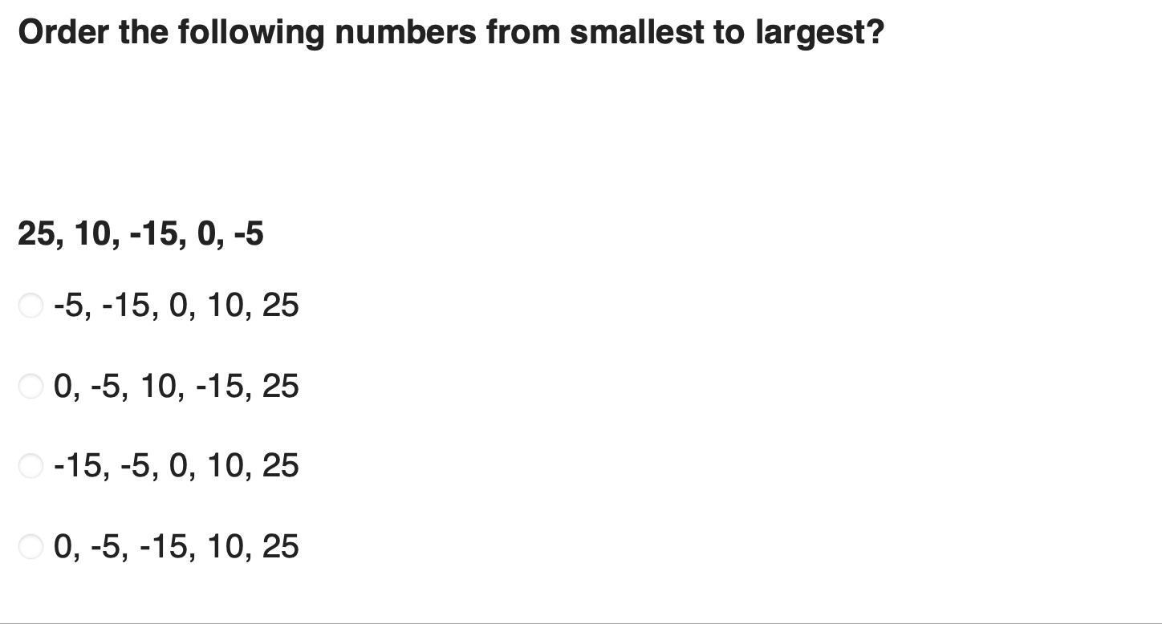
Lesson Quiz: Part I

Slide 14
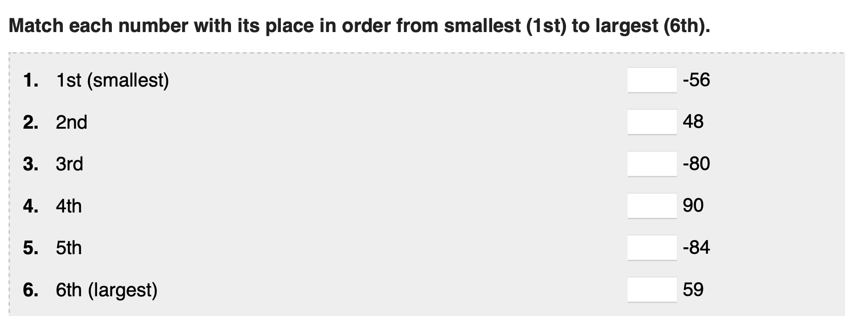
Lesson Quiz: Part II

Slide 15
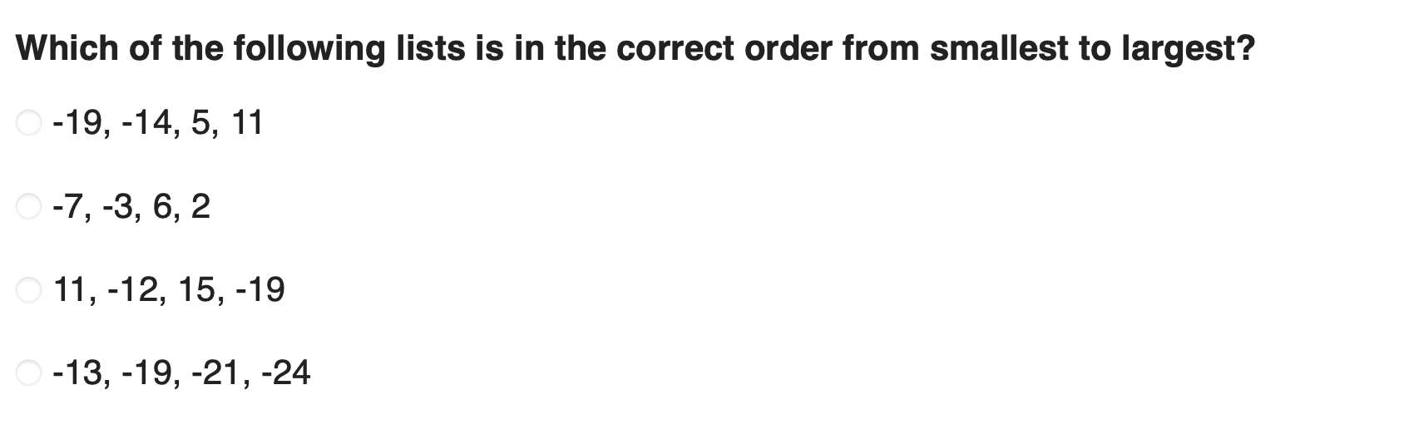
Lesson Quiz: Part III

Slide 16
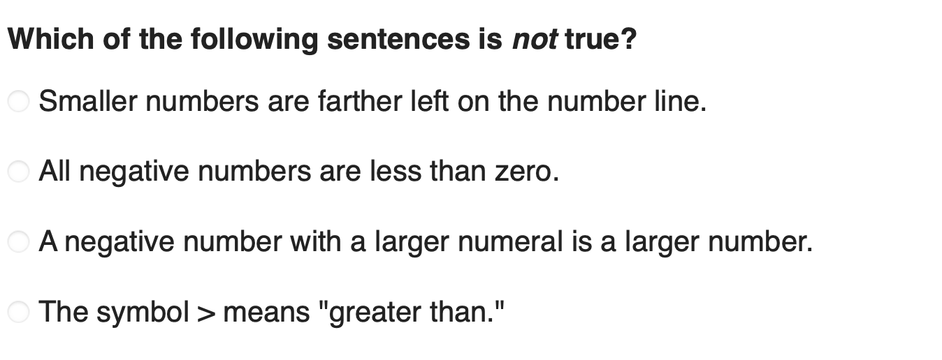
Lesson Quiz: Part IV

Slide 17
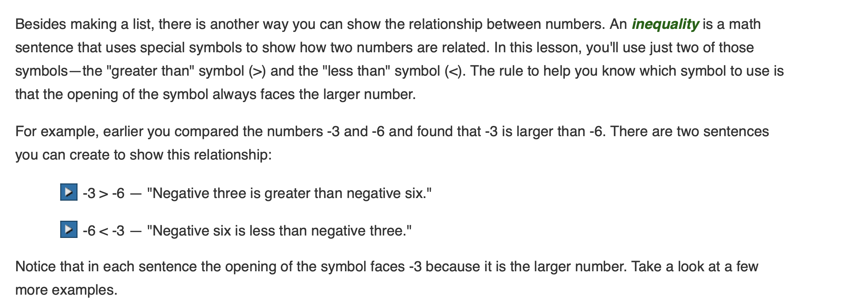
USING INEQUALITY SYMBOLS TO COMPARE INTEGERS

Slide 18
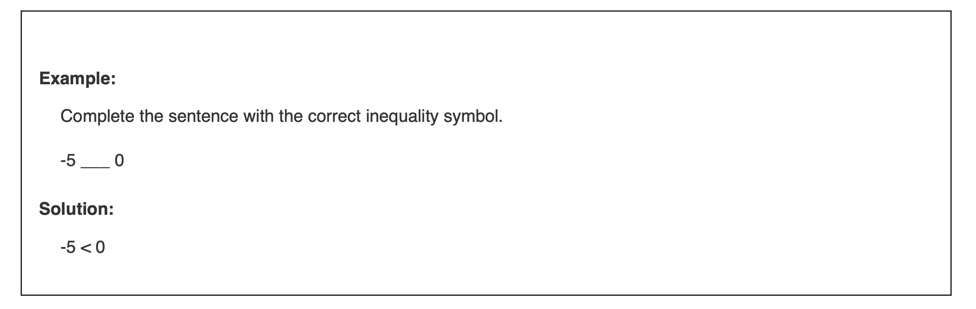
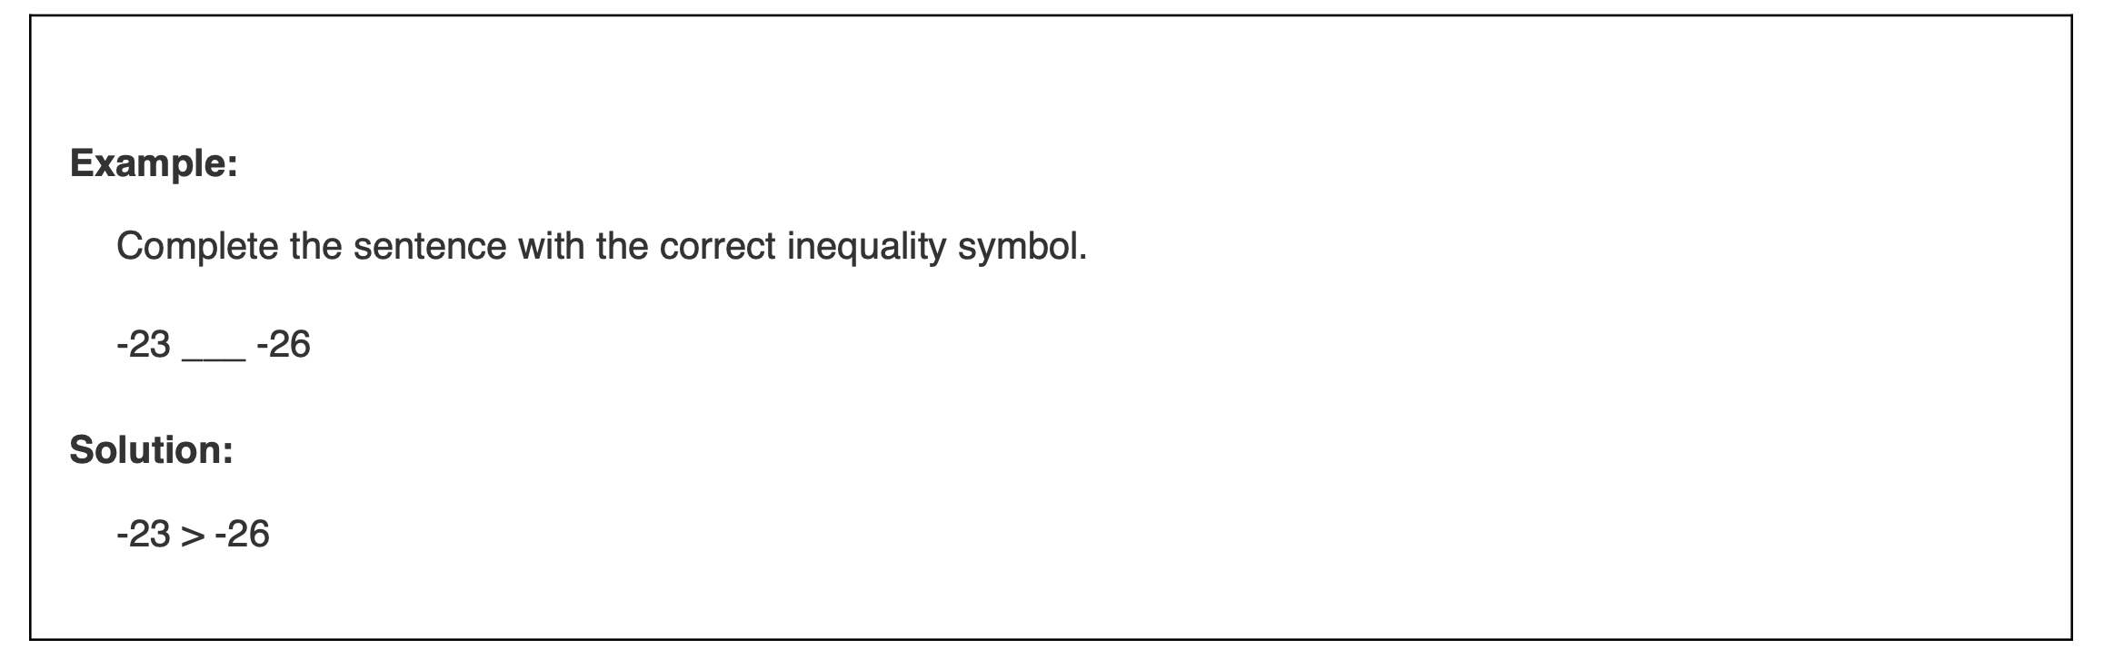

USING INEQUALITY SYMBOLS TO COMPARE INTEGERS

Slide 19
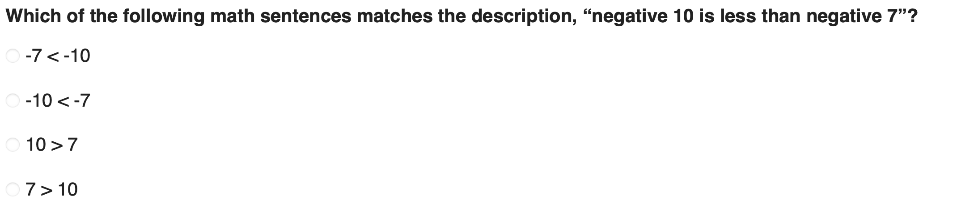
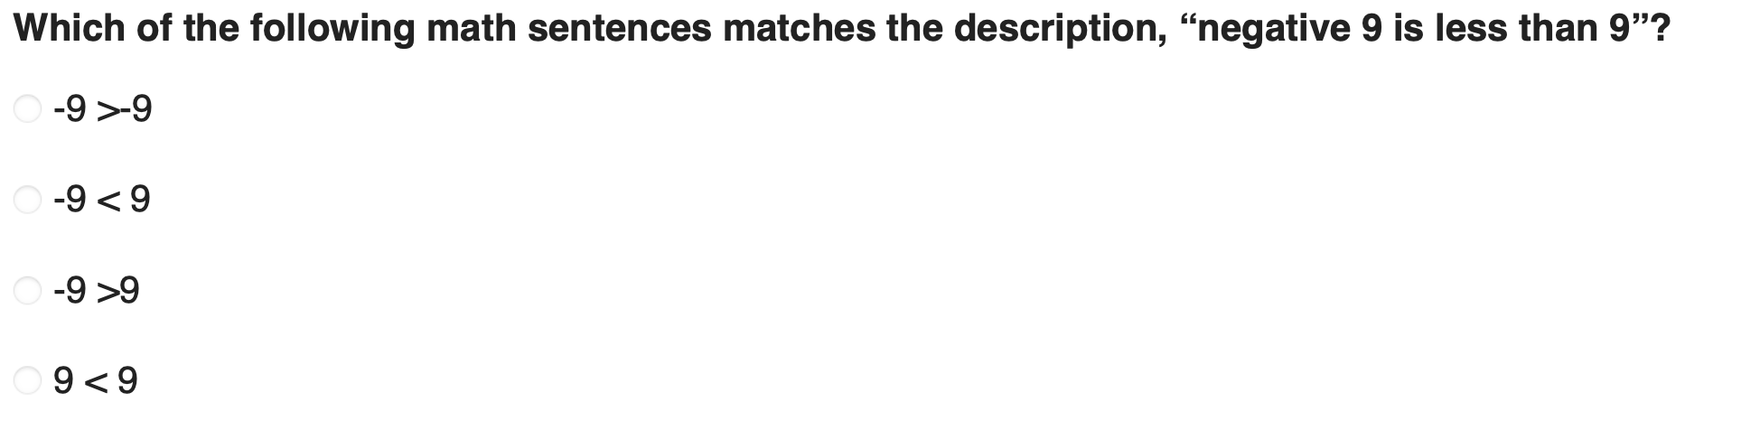
Lesson Quiz: Part V

Slide 20
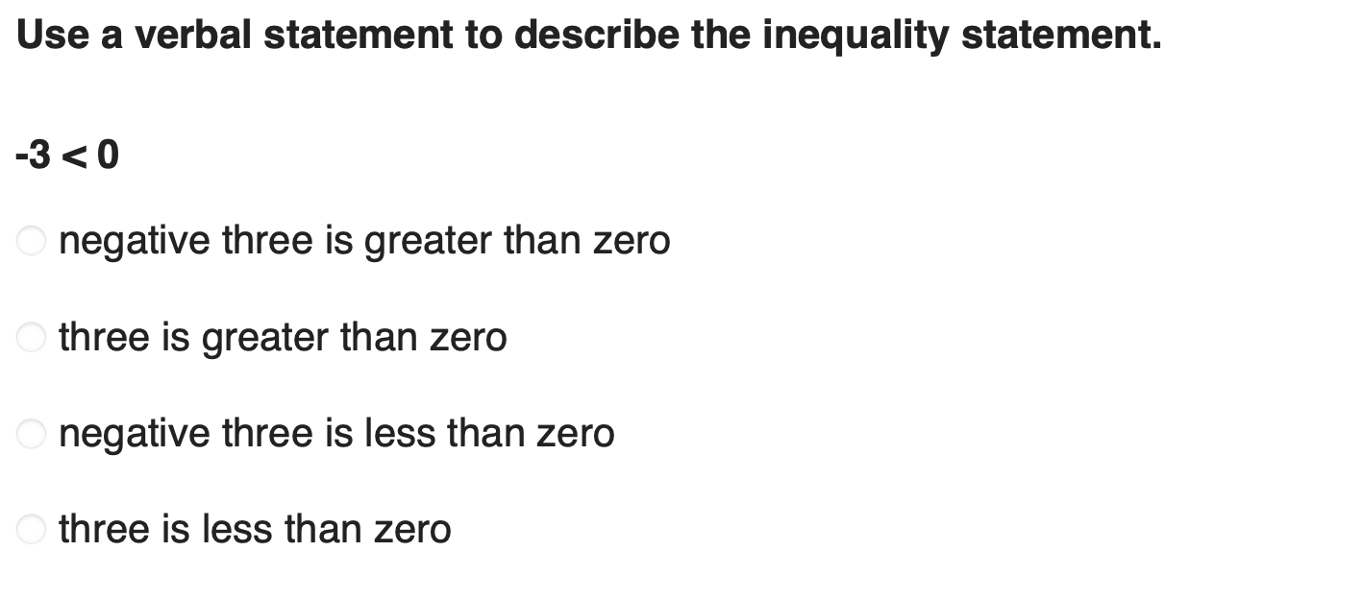
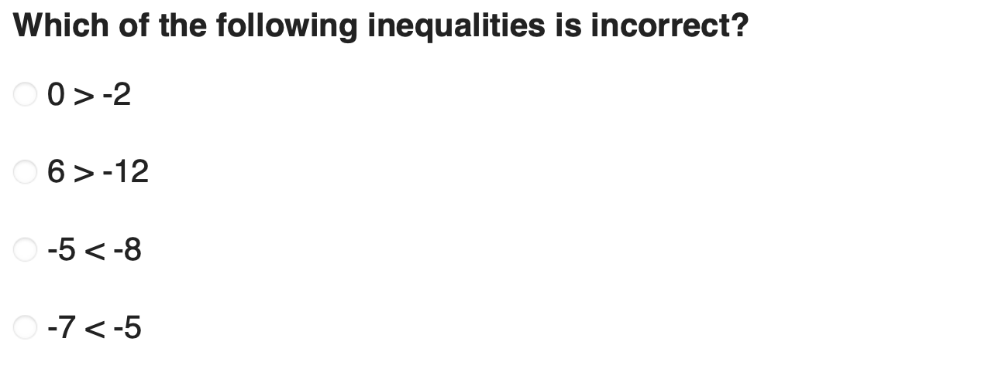
Lesson Quiz: Part V

